Slide 1
A Survey of Peer-to-Peer Content Distribution Technologies
Stephanos Androutsellis-Theotokis and Diomidis Spinellis
ACM Computing Surveys, December 2004
Wooyoung Park, Seyoung Kim

Slide 2
Defining Peer-to-Peer Computing
Strictest definition of peer-to-peer
All nodes are completely equivalent in terms of functionality and tasks they perform.
These definitions fail to encompass systems that employ the notion of “supernodes”, which are widely accepted as peer-to-peer
Definition in Shirky[2000]
“peer-to-peer is a class of applications that take advantage of resources—storage, cycles, content, human presence—available at the edges of the internet”
This definition encompass systems that completely rely upon centralized servers for their operation
Author’s suggestion
Sharing of computer resources by direct exchange, rather than requiring the intermediation of a centralized server.
Ability to treat instability and variable connectivity, automatically adapting to failures in both network connections and computers

Slide 3
Author’s Definition Proposal
Peer-to-peer systems are distributed systems consisting of interconnected nodes able to self-organize into network topologies with the purpose of sharing resources such as content, CPU cycles, storage and bandwidth, capable of adapting to failures and accommodating transient populations of nodes while maintaining acceptable connectivity and performance, without requiring the intermediation or support of a global centralized server or authority

Slide 4
Classification of Peer-to-Peer Applications
Communication and collaboration
Provide the infrastructure for facilitating direct, usually real time communication between peer computers.
Distributed computation
Aim is to take advantage of the available peer computer processing power.
Breaking up and distributing the tasks and collecting the results.
Internet Service Support
Multicast systems, security applications
Database Systems
Local relation model : all data stored in inconsistent local relational databases.
Content distribution
Include systems and infrastructures designed for the sharing of data between users
Relatively simple to more sophisticated systems
Napster, Gnutella, Freenet, Chord, Scan, PAST
This survey focus on content distribution

Slide 5
Peer-to-Peer Content Distribution
Classification of P2P systems.
File exchange systems
Simple, one-off file exchanges between peers.
Light-weight without addressing security, availability, persistence.
P2P content publishing and storage systems
Distributed storage medium : users able to publish, store, and distribute content with security, persistency.
Security and persistency are main focus.
Classification of P2P infrastructures
Routing and location
Route with efficiency and fault tolerance, efficiently locating peers and content
Anonymity
Provide user anonymity
Reputation management
Reputation update with various network nodes. Need reputation management infrastructures.

Slide 6
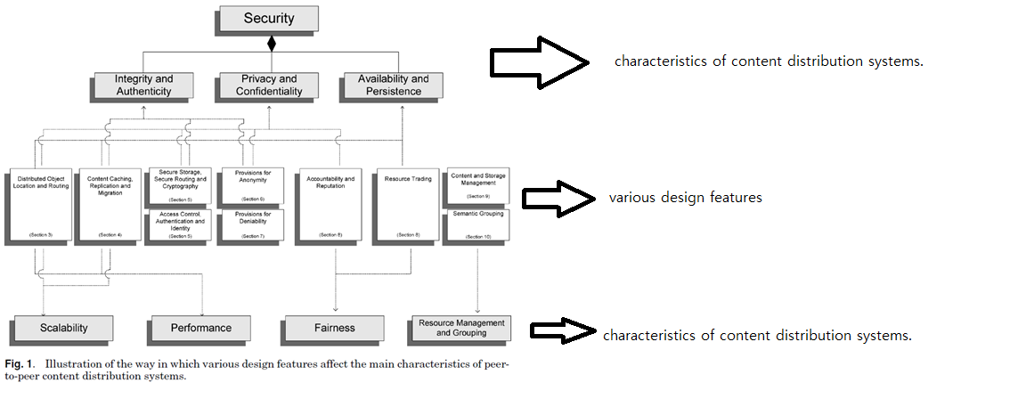
Analysis Framework

Slide 7
Content Distribution System Characteristics
Security
Integrity and authenticity : data completeness and safeguarding.
Privacy and confidentiality : only authorized user can access data.
Availability and persistence : authorized users have access to data when required.
Scalability
Although the number of nodes/documents is dramatic increased, system’s performance should be maintained.
Performance
Fairness
Resource management : management of editing, removal, storage space, metadata operation.

Slide 8
Peer-to-Peer Distributed Object Location and Routing
Overlay network : network of peer computers and connections between them, formed on top of underlying physical computer network.
Classify : centralization, structure.

Slide 9
Overlay Network Centralization
Purely decentralized architectures
All nodes act as both servers and clients(servents)
Partially centralized architectures
Some nodes has more important role(supernode)
Hybrid decentralized architectures
Central server with querys.
unscalable

Slide 10
Network Structure
Whether the overlay network is created deterministically or non-deterministically
Unstructured
Location of file is completely unrelated to overlay topology.
Appropriate highly transient node populations.
Have matters of scalability, persistence, availability.
Loosely structured
Location of file is affected by routing hints.
Structured
File is placed at specified locations.
Offer exact-match queries.
Strong for scalability but week for highly transient node.

Slide 11
Classification of P2P Content Distribution
 | Hybrid | Partial | none
Unstructured | Napster | Kazza | Gnutella
Loosely structured |  |  | Freenet
Structured |  |  | Chord, CAN, Tapestry

Slide 12
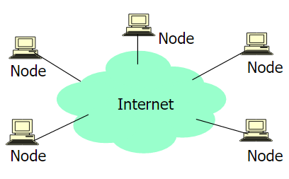
Unstructured architectures
Purely decentralized architecture
All nodes perform exactly same tasks, act as both servers and clients(servents)
No central coordination
Users connect to each other directly through software application.
e.g. original Gnutella

Slide 13
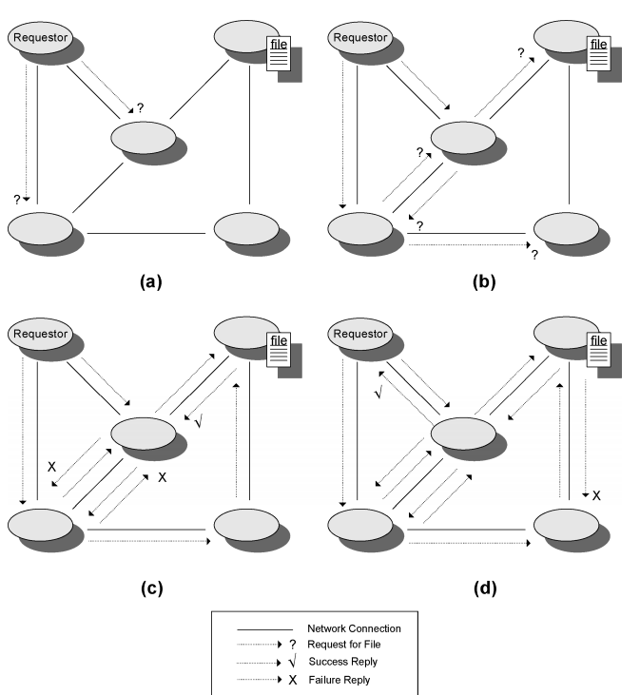
Purely Decentralized P2P Network
Ping : request for connect
Pong : reply message with host info
Query : search request with search string and minimum speed req.
Query hits : reply to query message with IP, port, speed.

Slide 14
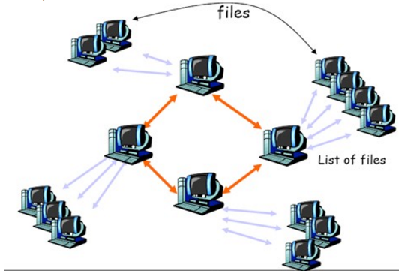
Unstructured Architectures
Partially centralized architectures
Some nodes act as local central indexes for shared files(supernode)
Supernodes are dynamically assigned. Supernodes have connection with other supernodes.
Node with enough CPU power joins the network, it becomes supernode.
Advantage
Discovery time is reduced
Most of nodes(normal node) are lightly loaded
E.g. Kazza

Slide 15
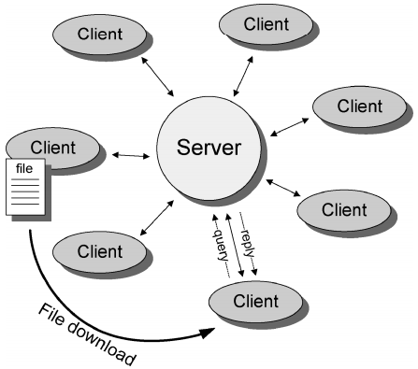
Unstructured Architectures
Hybrid decentralized architectures
E.g. Napster
Central server interacts between peers
Central server holds
directories of metadata(location of shared file)
User connection information table
Client gets file location from server, connect to client.
Advantage
Simple to implement
Locate file quickly and efficiently
Disadvantage
Vulnerable to attack, failure.
Lack of scalibility

Slide 16
Shortcoming and its Overcoming of Unstructured Architectures
Unstructured P2P systems have unscalability matter.
Each node chooses a neighbor at random, propagates the request only to it [Lv et al 02]
Chooses a neighbor based on their past history, local indices. [Yang 02]
Choose a neighbor based on profile that have information about their performance in recent queries[Kalogeraki 02]

Slide 17
Freenet - Loosely Structured Architecture
Loosely structured
Nodes can produce estimation of which nodes most likely to have files.
use a chain mode propagation
Local decision of node to send
Avoid blindly broadcasting request message to all
Files are identified by unique binary keys.
Made by hash function(simplest way)
Nodes maintain local data store and dynamic routing table
Freenet message form
Node ID, TTL, source and dest node ID

Slide 18
Freenet - Message Types
Data insert
Inserts new data(key and actual data) in the network.
Insert process
Node calculates a binary key for the file.
Node sends a data insert message to itself.
If key is not found
Node looks up the closest key in its routing table, and forwards message to the corresponding node.
Newly inserted files are placed at nodes possessing files with similar keys.
If key is found
Node returns the preexisting file

Slide 19
Freenet - Message Types
Data request
Request of the file using key of the file
Request process
If the node store a file
Search stop, forward back data to requestor with “data reply” message
If the node does not store a file
Forwards the request to its neighbor that is most likely to have the file
Message propagate from node-to-node
If hops-to-live value expired
Send back “data failed” message.

Slide 20
Freenet - Message Type
Data reply
When the requested file is located, actual files with “data reply” message are sent to request node
Data fail
When a node receives a “data fail” message, selects the next best node and forwards the request.
If all nodes have been explored and failed, it sends back “data fail” message.
Data request/reply/fail procedure is backtracking search with limited number of forwarding.

Slide 21
Freenet - Indirect Files, Properties
Indirect Files
A special class of lightweight files
Named according to search keywords
Contain pointers to the real file
Multiple files with the same key
Freenet properties
Nodes specialize in searching for similar keys over time
Nodes store similar keys over time
Similarity of keys does not mean similarity of files.
Routing does not reflect the underlying network topology

Slide 22
Chord - Structured Infrastructures
Identifies data items (files) with keys and storing the (key, data item) pairs at the node that the keys map to
Keys are assigned both to files and nodes by means of a deterministic function.

Slide 23
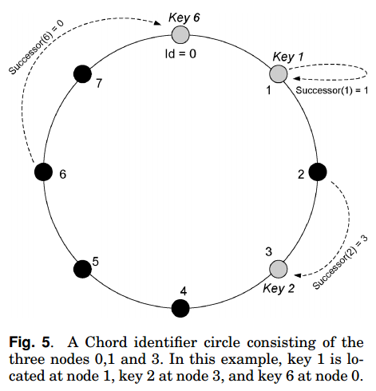
Chord - Structured Infrastructures
Identifier circle modulo 2^{m}
Key k is assigned to node k or
after k(the successor node of key k)
Roughly the same number of keys
Routing information : Each node should
be aware of its successor node.

Slide 24
Chord - Structured Infrastructures
Queries for a given key are passed around the circle via these successor pointers until a node with the key.
When a new node n joins, keys moves from n’s successor to node n.
When node n leaves, all keys assigned to it will be
reassigned to its successor.

Slide 25
Chord - Structured Infrastructures
Only one data element per node need to be correct to guarantee correct routing of queries
Availability remains high only as long as nodes fail independently
Performance degrades gracefully

Slide 26
Chord - “finger table”
In the worst case, Chord visits all N nodes to find a certain key.
Chord uses “finger table” to increase the efficiency.
Each entry i points to the successor of node n + 2i.
For a node n to perform a lookup for key k, it identifies the highest node n* whose ID is between n and k.(if not found, the successor of n is returned)
With the finger table, O(logN) bits & time.

Slide 27
4. Content Caching, Replication and Migration
P2P content distribution systems rely on the replication of content for
1. The availability of content
2. Performance
3. Resisting censorship attempts

Slide 28
4. Content Caching, Replication and Migration
Content replication can be categorized as follows:
Passive Replication
Cache-Based Replication
Active Replication
Instrospective replica management
Dynamic replica management

Slide 29
4.1. Passive Replication
Content replication occurs naturally as nodes request and copy content from one another

Slide 30
4.2. Cache-Based Replication
The result of caching copies of content as it passes through nodes
In Freenet, a file is transferred through the network node-by-node
In the process, copies of the file are cached on all intermediated nodes

Slide 31
4.3. Active Replication
Proactive content replication and migration methods are often employed

Slide 32
4. Replication Issues
By replicating content, data consistency and synchronization issues come up
Some application effectively decide to weaken their consistency restrictions in favor of more extensive data replication and higher availability

Slide 33
5. Security
Due to their open and autonomous nature, there are challenges:
Availability
Privacy
Confidentiality
Integrity
Authenticity
The network nodes must be considered untrusted parties

Slide 34
5.1. Security - Secure Storage
Self-Certifying Data
Integrity can be verified by the node retrieving it
Information Dispersal
By Rabin[1989]
Files are encoded into m blocks
Any n is sufficient to reassemble the original data (m < n)
Gives resilience
Distributed steganographic file systems
Encrypted blocks are indistinguishable from a random block
Their presence cannot even be detected

Slide 35
5.2. Security - Secure Routing
The goal of secure routing : To resolve the problem of malicious nodes attempting to corrupt, delete, deny access to, or supply stale copies of object replicas that are transferred between nodes

Slide 36
5.3. Security - Access Control, Authentication and Identity Management
The goal of secure routing : To resolve the problem of malicious nodes attempting to corrupt, delete, deny access to, or supply stale copies of object replicas that are transferred between nodes

Slide 37
5.3. Security - Access Control, Authentication and Identity Management
“Sybil Attack” - same physical entity can appear under different identities
It poses a security threat, especially in p2p systems that employ content replication or fragmentation schemes
Douceur [2002], concludes that unless a central certification or identification authority is employed, p2p system will be susceptible to this kind of attack.
The only proposed alternative: resource-demanding identification challenges

Slide 38
6. Provisions for Anonymity
For privacy, confidentiality, and censorship resistance
Anonymity refers to
The author of the content
The identity of a node storing the content
The identity and details of the content itself
The details of a query for retrieval of the content

Slide 39
6.1. Disassociation of Content Source and Requestor
Freenet is designed to provide anonymity by
Making it infeasible to discover the true origin or destination of a file passing through its network
Making it difficult for a node operator to determine if responsible for the actual physical content of their own node
For anonymity, while a file is being passed, any node along this path can unilaterally decide to claim itself or another arbitrarily chosen node as the data source.

Slide 40
6.2. Anonymous Connection Layers
Freenet is designed to provide anonymity by
Making it infeasible to discover the true origin or destination of a file passing through its network
Making it difficult for a node to determine if responsible for the actual physical content of their own node

Slide 41
6.3. Censorship Resistant Lookup
Achord system proposed a censorship resistant design
Publisher, storer, and retriever anonymity
Difficult for a node to voluntarily assume responsibility for a certain document

Slide 42
7. Provisions for Deniability
Refers to each user’s ability to deny knowledge of content stored in their node
Users cannot be held responsible for the content stored in their node

Slide 43
7.1. Deniability of Stored Content
Storing encrypted shares of files and no keys for them
Cannot know the content of the files whose shares they are storing
Distributed steganographic storage systems
Offers deniability through the fact that blocks of files that are written on a peer node’s file system are undetectable

Slide 44
7.2. Deniability of Content in Transit
The use of anonymous connection layers

Slide 45
7. Nondeniability in Structured Systems
Structured systems are nondeniable.
From a file, the identity of the node that stores it is known
The owner of the node has no control over whether the file will be stored.
That is, not responsible for its file

Slide 46
8. Incentive Mechanisms and Accountability
An uncontrolled decentralized p2p system relies on the voluntary participation of its users.
Necessary to provide incentives
Operations, performance and availability rely on it

Slide 47
8.1. Reputation Mechanisms
eBay - successful centralized reputation systems
Goal is to take the locally generated reputation as a result of an interaction and spread it throughout the network to produce a global reputation
The Eigen-Trust algorithm : global reputation based on the history of uploads
The global reputation values are computed from the local reputation values assigned to a peer by other peers, weighted by the global reputation of the assigning peers

Slide 48
8.2. Micropayments Mechanisms
In MojoNation, a currency(“Mojo”) is gained by offering disk space, bandwidth, or CPU cycles.
Mojo is used to obtain access to distributed storage space.

Slide 49
8.3. Resource Trading Schemes
Each node publishes and digitally signs logs containing
lists of files it stores on behalf of remote nodes
lists of files that other nodes are storing on its behalf
no node is using more resources than it is providing
In FreeHaven, nodes form contracts to store each other’s material for a certain period of time
Fulfilling a contract -> increase in reputation
Dropping data earlier -> decrease in reputation

Slide 50
9. Resource Management Capabilities
The minimum operations
Inserting
Locating
Retrieving
Additional resource management facilities
Removing
Updating
Maintaining previous versions of updated content.

Slide 51
9.1. Content Deletion and Update
Not straightforward
MojoNation uses immutable files
PAST offers a delete functionality for reclaiming the disc space occupied by a file
It does not guarantee that the file will no longer be available anywhere in the network

Slide 52
9.2. Storage and Bandwidth Management
In PAST, users can use as much as they contribute on their node(quota system)
To protect from denial of service attacks, apart from enforcing a published size quota to users
Requests a publisher to carry out computational work

Slide 53
9.3. Other Resource Management
Content Versioning
Directory Structure
Content Searching

Slide 54
10. Semantic Grouping of Information
Interest-based “peer communities”
Making searching more efficient
The semantic overlay clustering approach
Based on partially-centralized(super-peer) networks
Creating logical layers above the physical network topology by matching semantic information provided by peers

